Slide 1

C O V I D – 1 9 A n a l y s i s
( U s i n g S Q L)

Slide 2
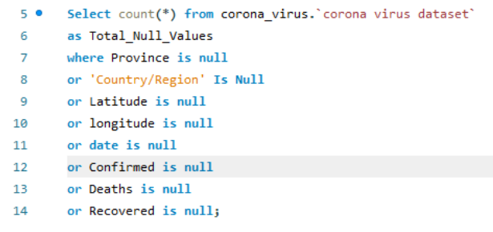
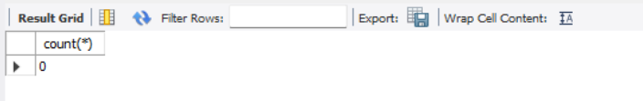
Q1. Write a code to check NULL values

Slide 3
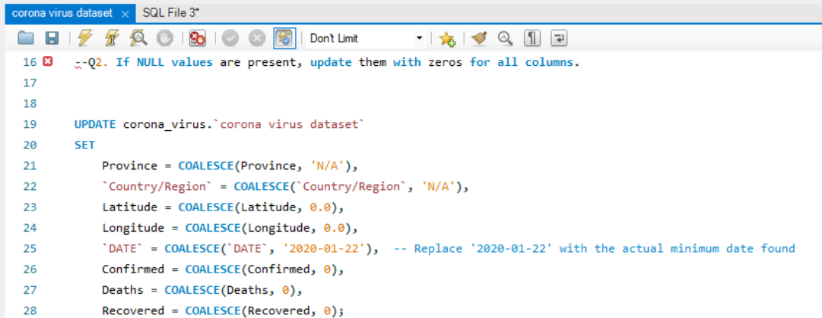
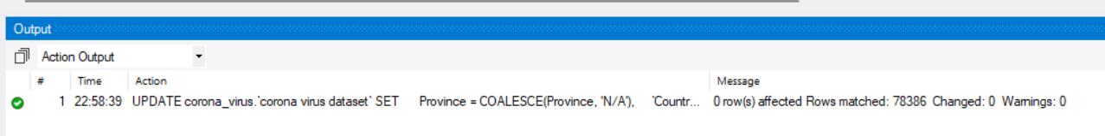
Q2. If NULL values are present, update them with zeros for all columns.

Slide 4
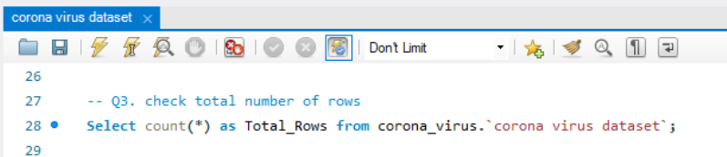
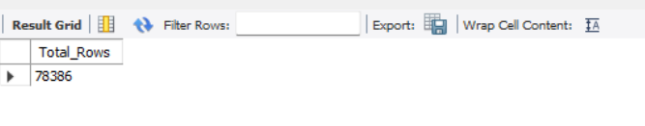
Q3. Check total number of rows

Slide 5
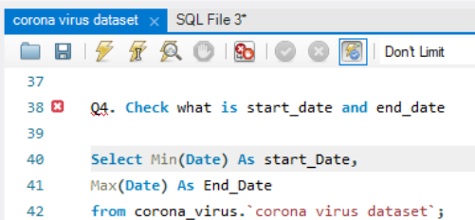
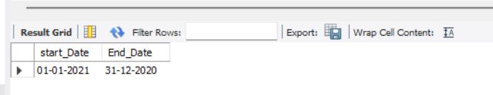
Q4. Check what is start_date and end_date

Slide 6
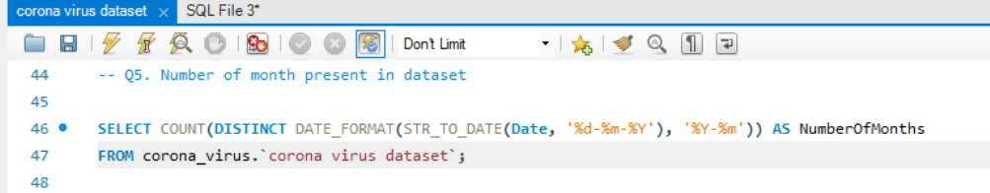
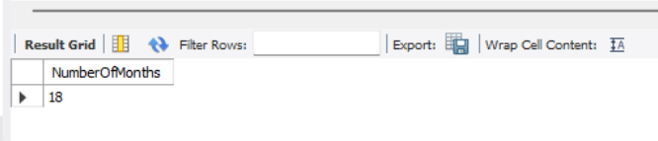
Q5. Number of month present in dataset.

Slide 7
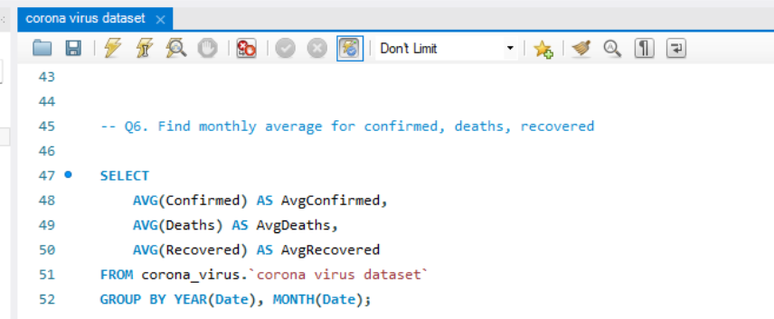
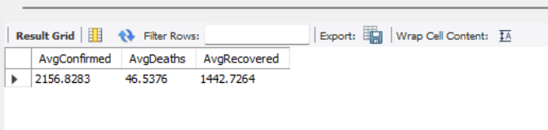
Q6. Find monthly average for confirmed, deaths, recovered.

Slide 8
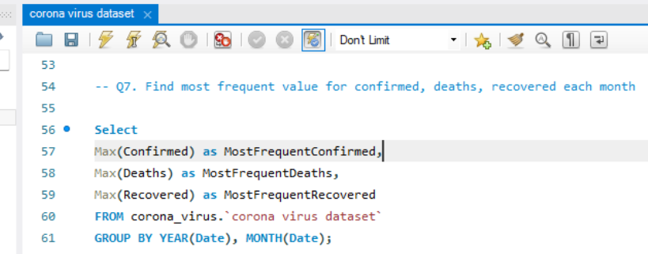
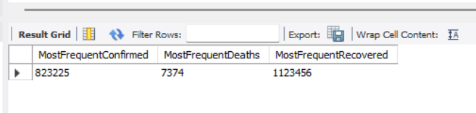
Q7. Find most frequent value for confirmed, deaths, recovered each month .

Slide 9
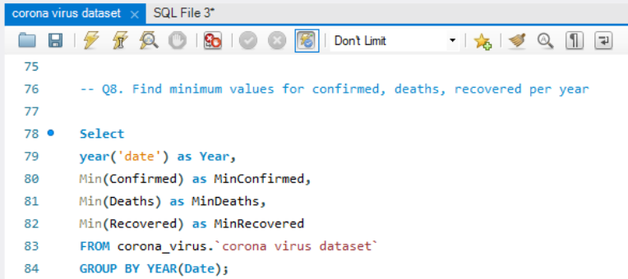
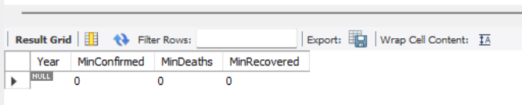
Q8. Find minimum values for confirmed, deaths, recovered per year

Slide 10
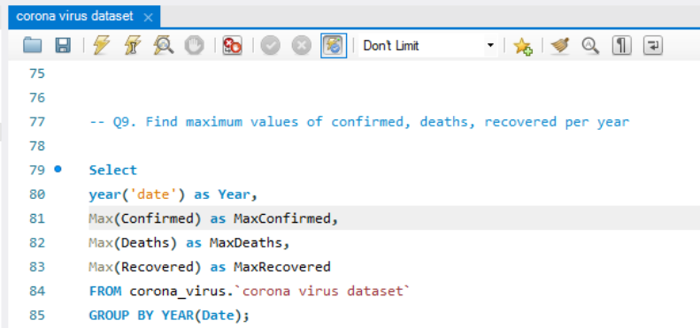
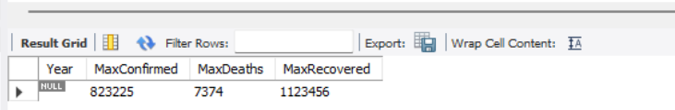
Q9. Find maximum values of confirmed, deaths, recovered per year

Slide 11
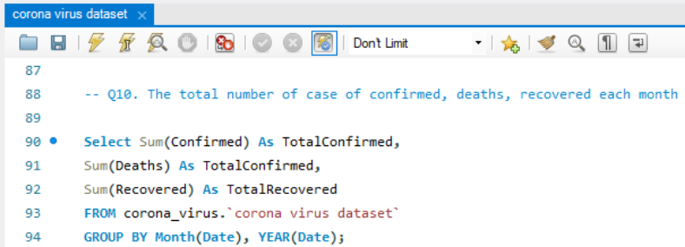
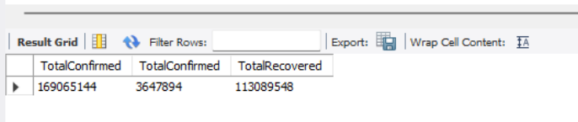
Q10. The total number of case of confirmed, deaths, recovered each month
This Photo by Unknown Author is licensed under CC BY-NC-ND

Slide 12
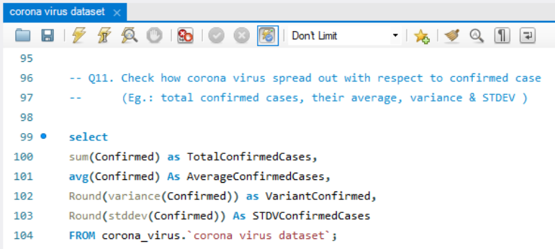
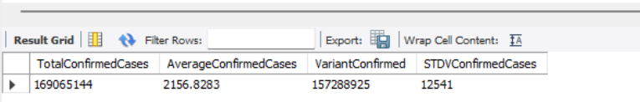
Q11. Check how corona virus spread out with respect to confirmed case.

Slide 13
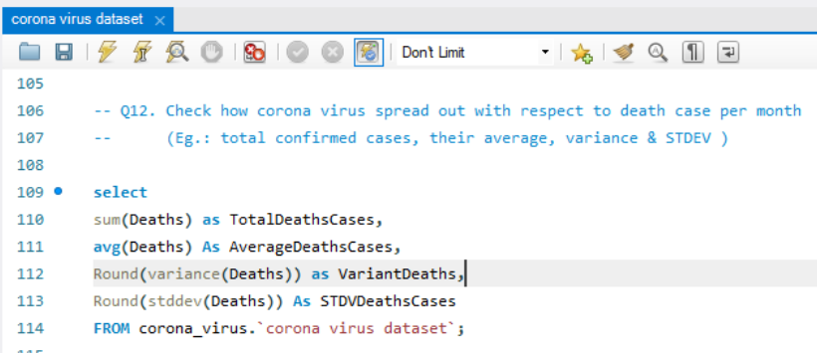
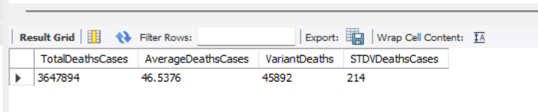
Q12. Check how corona virus spread out with respect to death case per month.

Slide 14
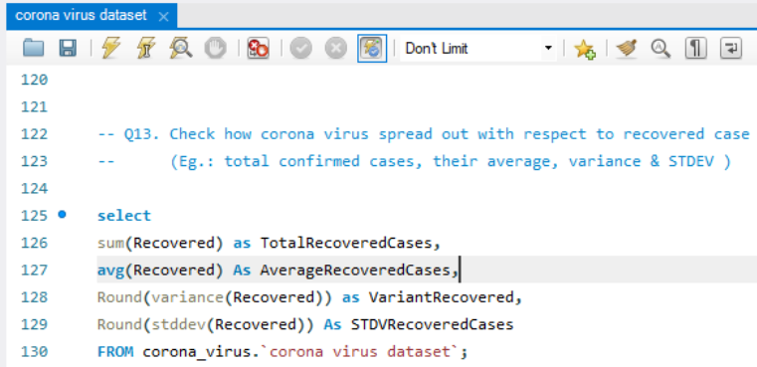
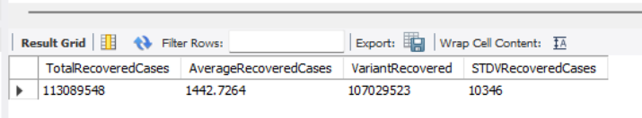
Q13. Check how corona virus spread out with respect to recovered case.

Slide 15
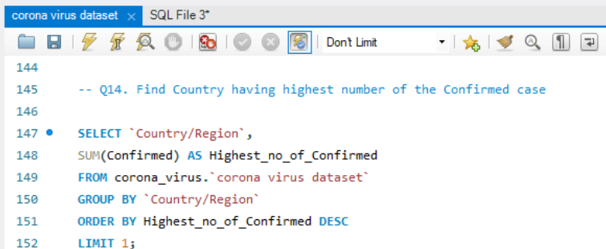
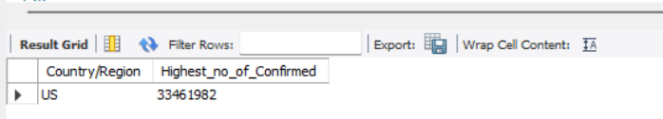
Q14. Find Country having highest number of the Confirmed case.

Slide 16
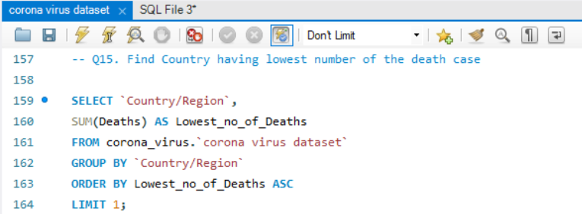
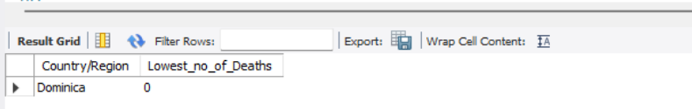
Q15. Find Country having lowest number of the death case

Slide 17
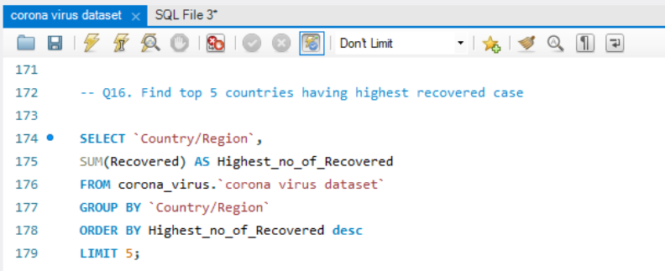
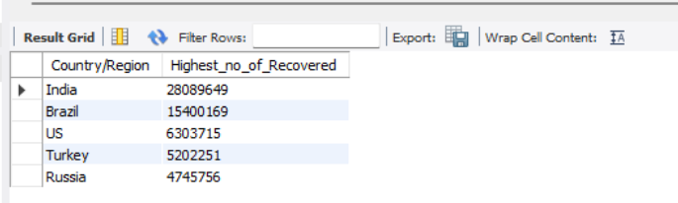
Q16. Find top 5 countries having highest recovered case.

Slide 18


THANKS FOR YOUR SUPPORT & GUIDANCE
My Gratitude to Mentorness!
urvashi-mehta-51332a231
https://github.com/UrvashiMehta07

